Slide 1


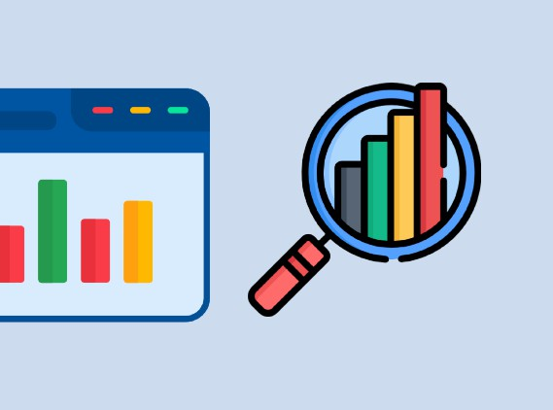
SQL Server and Python Data Analysis

Slide 2

About us
Analyze and visualize data efficiently using SQL Server for database management, Python for data manipulation and automation, and Power BI for interactive business intelligence reporting.

Slide 3

Agenda
Introduction
SQL Part
Python code
Power BI charts
Summary

Slide 4
Introduction
SQL Server: Design and manage relational databases with complex queries, joins to make the data more efficiency to next step and import it as csv file .
Python: Leverage Python’s powerful data manipulation libraries (Pandas, Matplotlib) to analyze, visualize, and automate insights from diverse datasets for data-driven decision-making.
Power BI: Utilize Power BI's dynamic dashboards and data visualization tools to create interactive reports that transform raw data into actionable insights for business intelligence.

Slide 5
SQL
What we make in SQL !!!
Create all tables and fill it with data using the attach file.
Check that all tables are fill with data SQL server.
Make joins between table to handle the data As much as possible to make it easy for next step.
let’s go to python part ☺

Slide 6
Python
What we make in python !!!
Load the extracted data into a Data Frame Using Pandas library.
Clean the data.
Handle missing values.
Filter out unnecessary records that will not be in any analysis
After finish all this steps we handle the data to make it easier to analysis in Power BI.
let’s go to the most amazing part ☺

Slide 7
Power BI
Sales Overview
Customer Demographics and Behavior
Music Performance

Slide 8
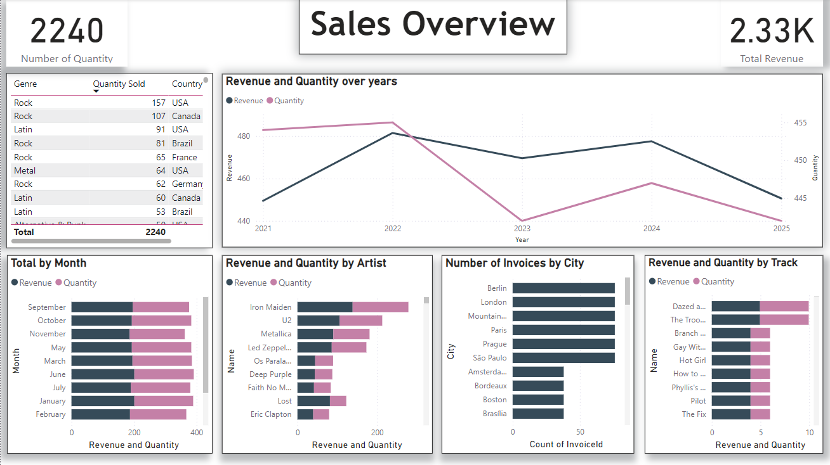
Power BI

Slide 9
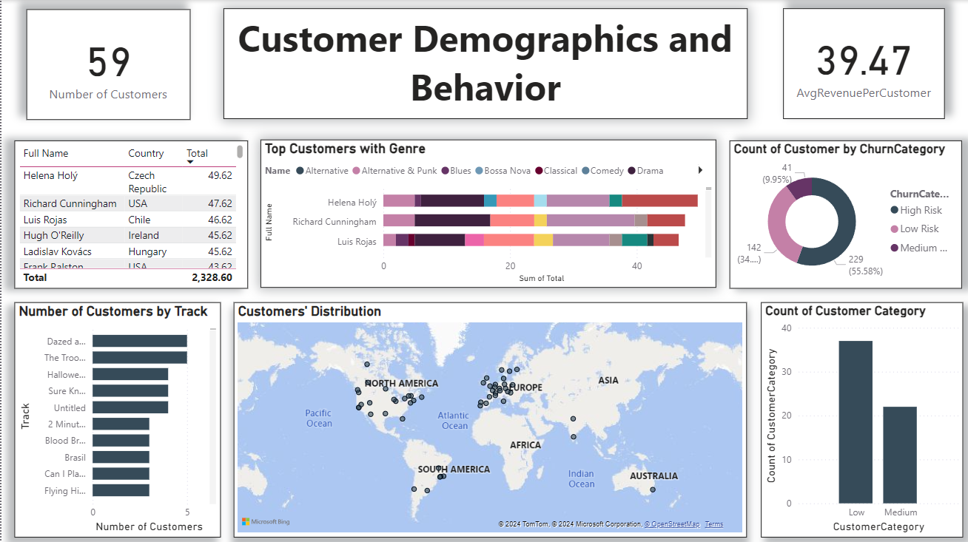

Slide 10
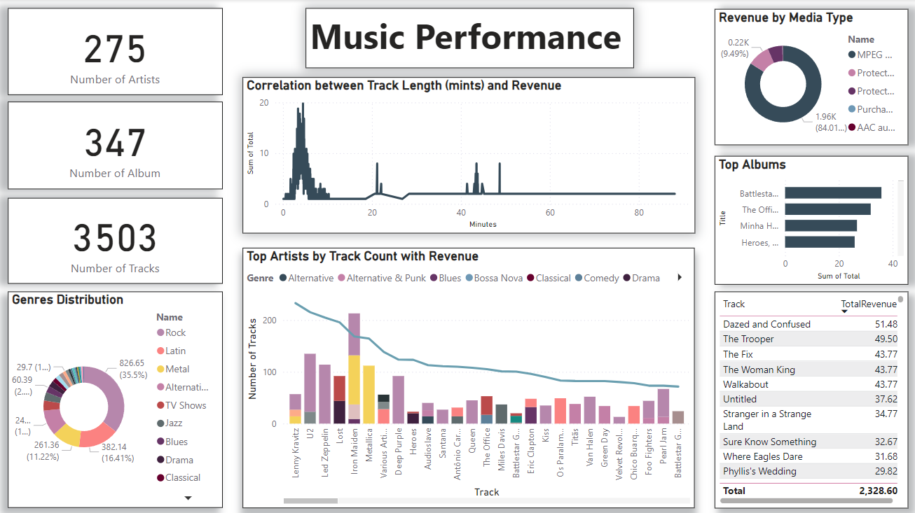

Slide 11
Sales Overview
Key Performance Indicators (KPIs)
Total Revenue: $2,330
Total Quantity Sold: 2,240 units
Number of Years Analyzed: 4 years (2021 - 2024)
Artist Name | Revenue | Quantity Sold
Iron Maiden | $138.60 | 140 units
U2 | $105.93 | 107 units
Metallica | $90.09 | 91 units
Led Zeppelin | $86.13 | 87 units
Os Paralamas Do Sucesso | $43.56 | 45 units
Genre | Quantity Sold | Revenue Generated | Percentage of Total Revenue
Rock | 835 units | $826.65 | 35.5%
Latin | 386 units | $382.14 | 16.41%
Metal | 264 units | $261.36 | 11.22%
Alternative & Punk | 244 units | $241.56 | 10.37%
TV Shows | 47 units | $93.53 | 4.02%
Total | 2,240 units | $2,330 | 100%
Media Type | Quantity | Revenue Generated
MPEG audio file | 1976 units | $1956.24
Protected MPEG-4 | 111 | $220.89
Total |  | $2,330

Slide 12

City | Number Of invoices | Revenue Generated
Berlin | 76 units | $75.24
London | 76 units | $75.24
Mountain | 76 units | $75.24
Total | 2,240 units | $2,330
Year | Quantity Sold | Revenue Generated
2021 | 454 units | $449.46
2022 | 455 units | $481.45
2023 | 442 units | $469.58
2024 | 447 units | $477.53
Total | 2,240 units | $2,330
Track Name | Revenue | Quantity Sold
Dazed and Confused | $4.95 | 5 units
The Trooper | $4.95 | 5 units
Branch Closing | $3.98 | 2 units
Gay Witch Hunt | $3.98 | 2 units
Hot Girl | $3.98 | 2 units

Slide 13
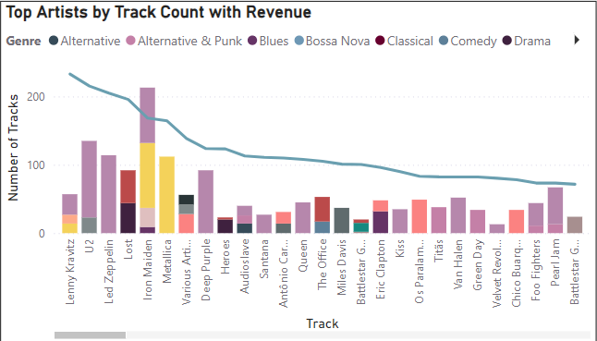
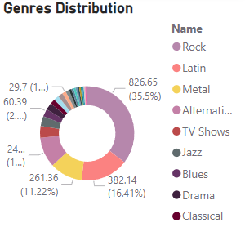
Top Artists by Genre Certain artists appear to dominate specific genres, contributing a significant number of tracks.

Slide 14
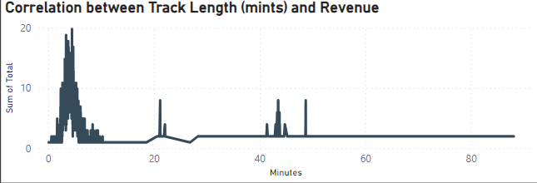
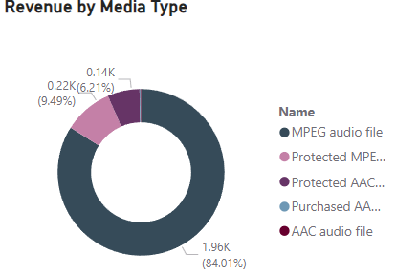
Track Length: The focus is on shorter tracks, ranging from 1 to 7 minutes. This could imply that consumers are more likely to purchase or listen to shorter tracks compared to longer ones.
Digital downloads are the highest revenue source

Slide 15
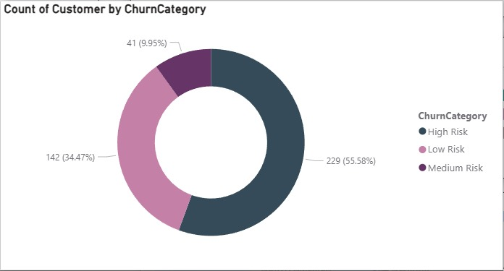
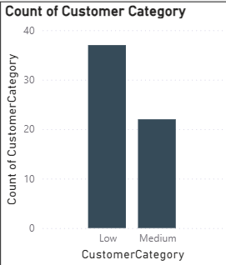
•Low Risk Customers: Customers who have made purchases within the last 6 months
•Medium Risk Customers: Customers who have made a purchase within the last 6 to 12 months
•High Risk Customers: Customers who have not made a purchase in over 12 months
Low: total Revenue <= avg revenue
Medium: total Revenue >= avg revenue

Slide 16
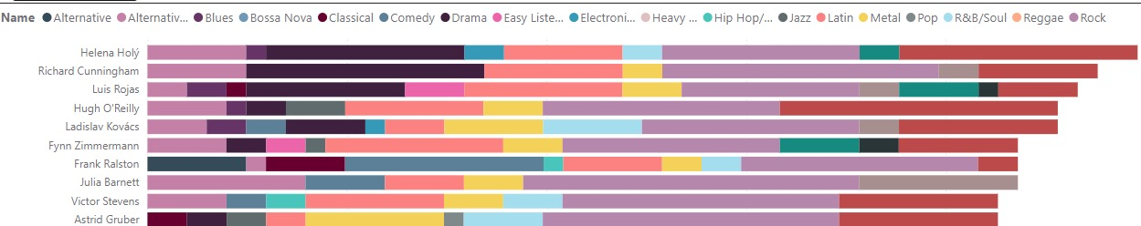
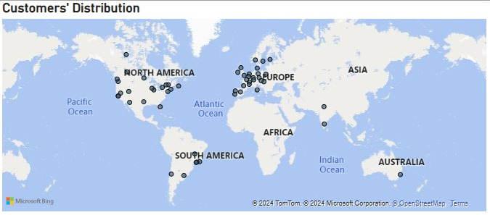
The chart reveals diverse musical tastes, with Rock, Blues, and Alternative being most popular. Individuals like Helena Holy and Hugh O'Reilly favor Rock, while Luis Rojas prefers Blues. Niche genres like Bossa Nova appear less frequently. Overall, there's a consistent presence of Jazz, Latin, and Electronic music.
Customer Geographic Distribution : The customers are distributed globally, with concentrations in North America, Europe, and South America. This geographic spread indicates diverse customer engagement, potentially enabling market-specific promotions.

Slide 17
Recommendations
1-Targeted Marketing Campaigns
Genre-Specific Promotions: Develop marketing campaigns for Rock and Alternative genres, featuring popular tracks and artists. Offer limited-time promotions or discounts to boost sales.
Personalized Email Campaigns: Utilize customer data to craft personalized emails that highlight new releases, artist spotlights, and curated playlists matching customers' preferences.
2-Customer Retention Strategies
Loyalty Programs: Implement loyalty programs to reward frequent, low-risk customers with discounts, exclusive content, or early access to new releases.
Re-engagement for Medium and High-Risk Customers: Send targeted re-engagement emails to medium-risk customers with special offers. For high-risk customers, consider direct outreach to understand their needs.
3-Leverage Customer Insights
Utilize Top Customer Data: Create exclusive promotions for top customers, offering access to events, merchandise, or limited editions to maintain loyalty and increase lifetime value.
Churn Analysis Utilization: Continuously analyze churn data to identify patterns and address potential triggers, regularly adapting marketing efforts based on findings.
4-Expand Geographic Outreach
Localized Promotions: Tailor marketing strategies for North America, Europe, and South America, using local events and collaborations with regional artists.
City-Specific Campaigns: Focus on cities with the highest sales, like Berlin and London, organizing events or partnerships to engage local audiences.

Slide 18
5-Content Strategy
Focus on Shorter Tracks: Highlight shorter tracks (1 to 7 minutes) in promotional materials and playlists, creating easy listening and sharing options.
Digital Offerings: Enhance the digital catalog by including more formats, exclusive tracks, or artist collaborations to attract a wider audience.
Compilations and Playlists: Curate compilations or playlists of shorter tracks within the Rock genre to enhance discoverability and encourage sharing among listeners.
6-Sales Performance Tracking
Regular KPI Monitoring: Establish a routine for reviewing KPIs (revenue, quantity sold, customer demographics) to adjust marketing strategies timely.
Conduct Market Research: Analyze consumer behavior and market trends to understand factors contributing to revenue declines in 2024, adjusting strategies accordingly.
7-Diversity in Offerings
Explore Niche Markets: Investigate opportunities in niche genres like Blues and Bossa Nova, creating targeted campaigns to attract new customers and diversify revenue streams.
Cross-Genre Collaborations: Foster collaborations between artists from different genres to produce engaging content appealing to broader audiences.
8-Personalized Recommendations
Data Analytics for Recommendations: Utilize data analytics to provide personalized recommendations to customers based on their listening habits and preferences, enhancing their overall experience and encouraging repeat purchases.

Slide 19
Summary
SQL Server
Efficient database design and management using complex queries and joins.
Data extracted and processed for further analysis.
Python
Data cleaning and manipulation using Pandas.
Handling missing values, filtering unnecessary data.
Prepared data for Power BI visualization.
Power BI
Created interactive dashboards for business Analysis.
Provided insights into sales, customer demographics, and employee performance.

Slide 20
Any Questions

Slide 21

Thank you
Presented by
Abdelrahman Afify Hussien Team Leader (Full presentation & Python)
Nourhanne Salah Eldin Mohammed (Full Power BI)
Abdullah Saeed Mohammed (SQL Queries)
Youssef Ali Anwer (SQL Queries)
Marwan Mohammed Ibrahim (Python)

